Slide 1
watersheD delineation
AUTHOR: CHUKWU CHINYERE PRECIOUS

Slide 2
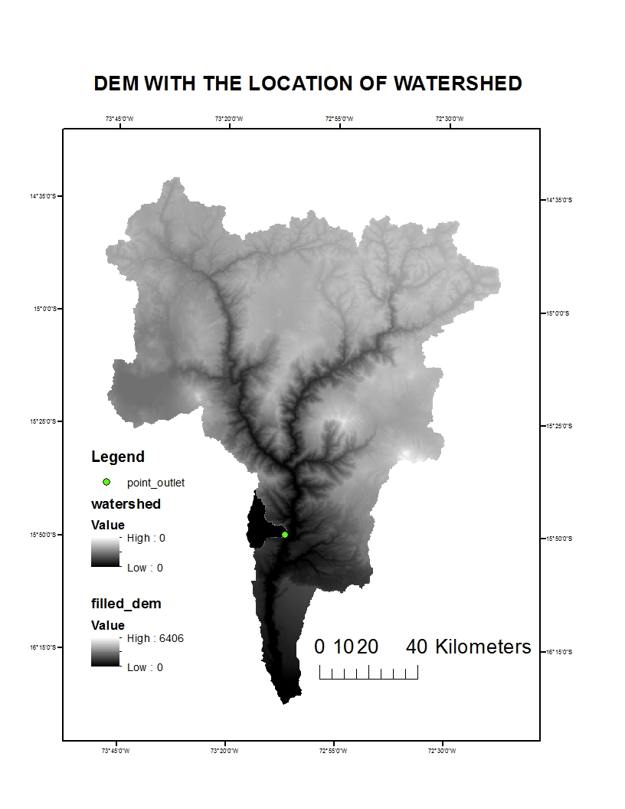

Slide 3
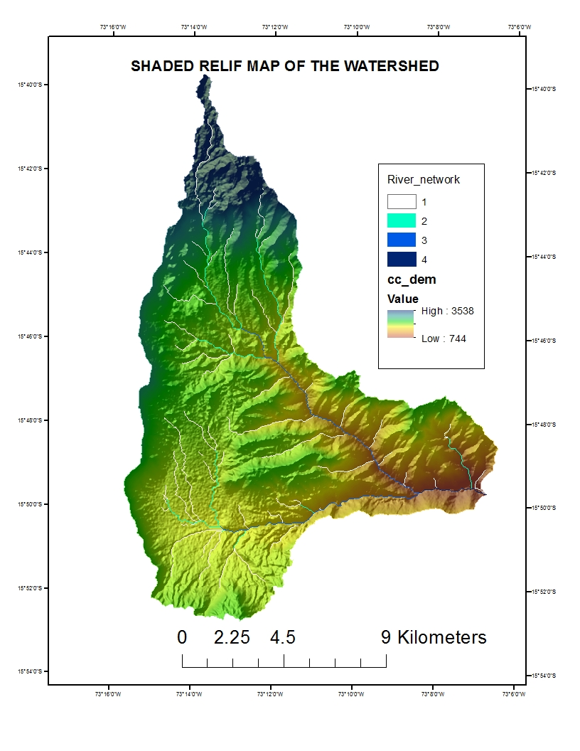

Slide 4
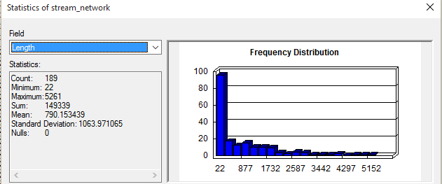
Information about the Lengths of Ordered Stream Segments and Sum Channel Network Length

